Slide 1
DevOps Project Simulation
SCHOOL SCHEDULE

Slide 3




CONTENTS
DESCRIPTION OF ROLES
WORK PLAN
WHAT IS DEVOPS?
OVERVIEW OF TOOLS
DEMO
ADOP CARTRIDGE
For Internal Use Only

Slide 4
Description of Roles
Roles | Responsibilities | Name
Team Lead | Overall in-charge of the project | cris.gievid.m.narca
CI/CD | In-charge of Configuration of Tools | anjhillian.s.cabrera, mari.cris.p.ayes
Developer | In-charge of the Development of Application that will be use | mari.cris.p.ayes, joey.ann.o.robles
Document – Writer | In-charge of Documenting the whole project | pauleen.s.pineda

Slide 5
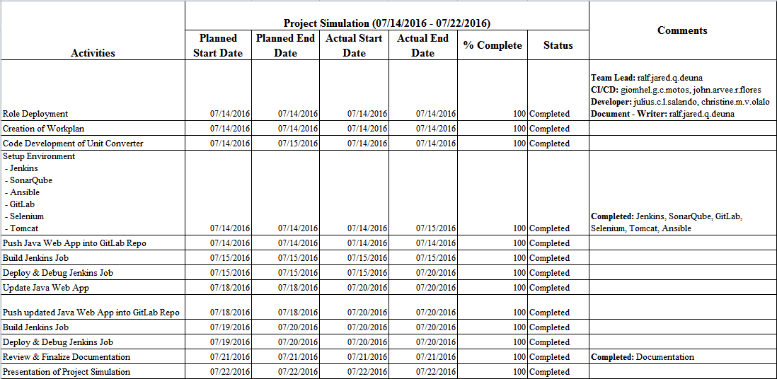
Work plan

Slide 6
What is DevOps?
Dev
Ops
DevOps

Slide 7
Introduction
Development Operations (DevOps) can be described as the overall practice of automating the process of software delivery and infrastructure changes
Different tools are integrated to ensure that projects are completely and correctly done in the entire service lifecycle, from design through the development process to production support

Slide 8
Overview of Tools
Amazon Web Services (AWS)
GitLab
Jenkins
Maven
SonarQube
Ansible
Tomcat
Selenium

Slide 9

Amazon Web Services (AWS) is a cloud services platform

Slide 10

Jenkins is an open source continuous integration tool written in Java

Slide 11

GitLab is an application to code, test, and deploy code together

Slide 12

Apache Maven is a software project management and comprehension tool

Slide 13

SonarQube is an open source tool used to measure and analyze code quality

Slide 14
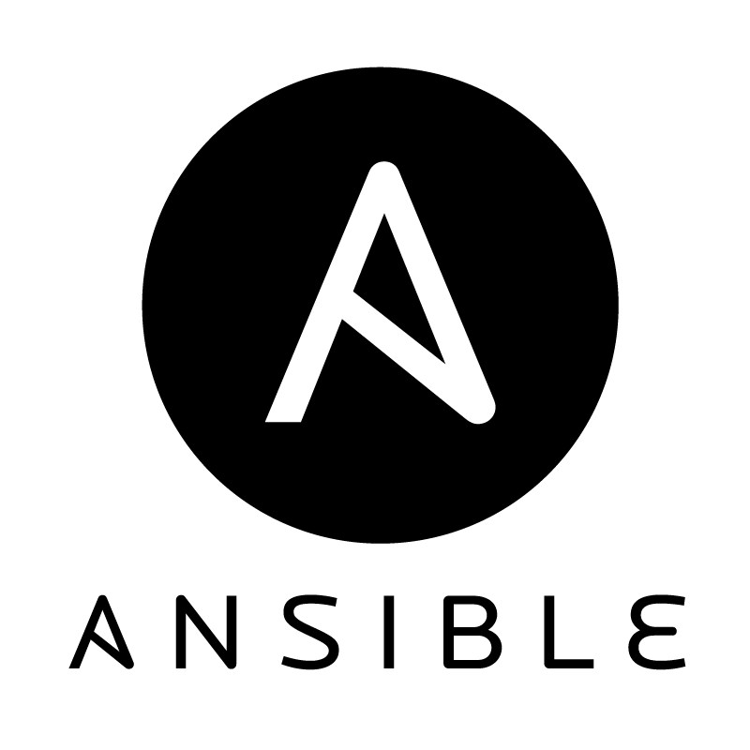
Ansible is a software platform for managing and combining multi node software deployment, as well as ad-hoc changes in the execution and configuration management of a system

Slide 15

Apache Tomcat, often referred to as Tomcat, is an open-source web server developed by the Apache Software Foundation (ASF)

Slide 16
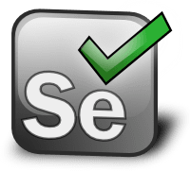
Selenium is a free (open source) automated testing suite for web applications across different browsers and platforms

Slide 17
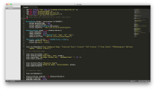







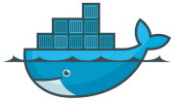



Developers
CI/CD
Client

Slide 18
DEMO
School schedule

Slide 19
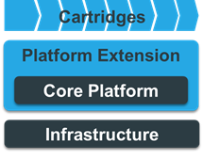
CARTRIDGE
A cartridge is a standardized approach of packaging and sharing reusable software delivery assets.
They will typically defines the Git repositories with sample code, Jenkins jobs and pipelines that define a reference implementation for a particular technology.
Cartridges can be loaded into the platform dynamically at any time and multiple cartridges can be loaded concurrently.
They are designed for modularity and reuse and as a means for people to contribute to the platform.
Cartridges are defined according to the cartridge specification which is implemented by the cartridge skeleton which can be used as a basis for cartridge development.
The architecture is based on three (perhaps three and a half layers).

Slide 20
CARTRIDGE
Cartridges can:
Be loaded at any time
Be combined to build support for complex system development
Be extended to include additional configuration beyond Jenkins pipelines, Git repositories and Sensu Checks
Creating cartridge :
Spin up an ADOP Core - https://github.com/Accenture/adop-docker-compose
Determine the scope of a Cartridge
Load the Cartridge development in order to develop your cartridge - https://github.com/Accenture/adop-cartridge-cartridge-dev
Create the Cartridge content
The architecture is based on three (perhaps three and a half layers).

Slide 21
CARTRIDGE
Test the cartridge :
Push cartridge to a Git repository
Add cartridge URL so it can be loaded
Via platform-management
Via modifying Load_Cartridge
Once a project has been created there will be a "Cartridge_Management/Load_Cartridge" job
This can be modified to add the cartridge Git repository URL to the parameter list (by default the cartridge development cartridge is included as an option)
The architecture is based on three (perhaps three and a half layers).

